Slide 1
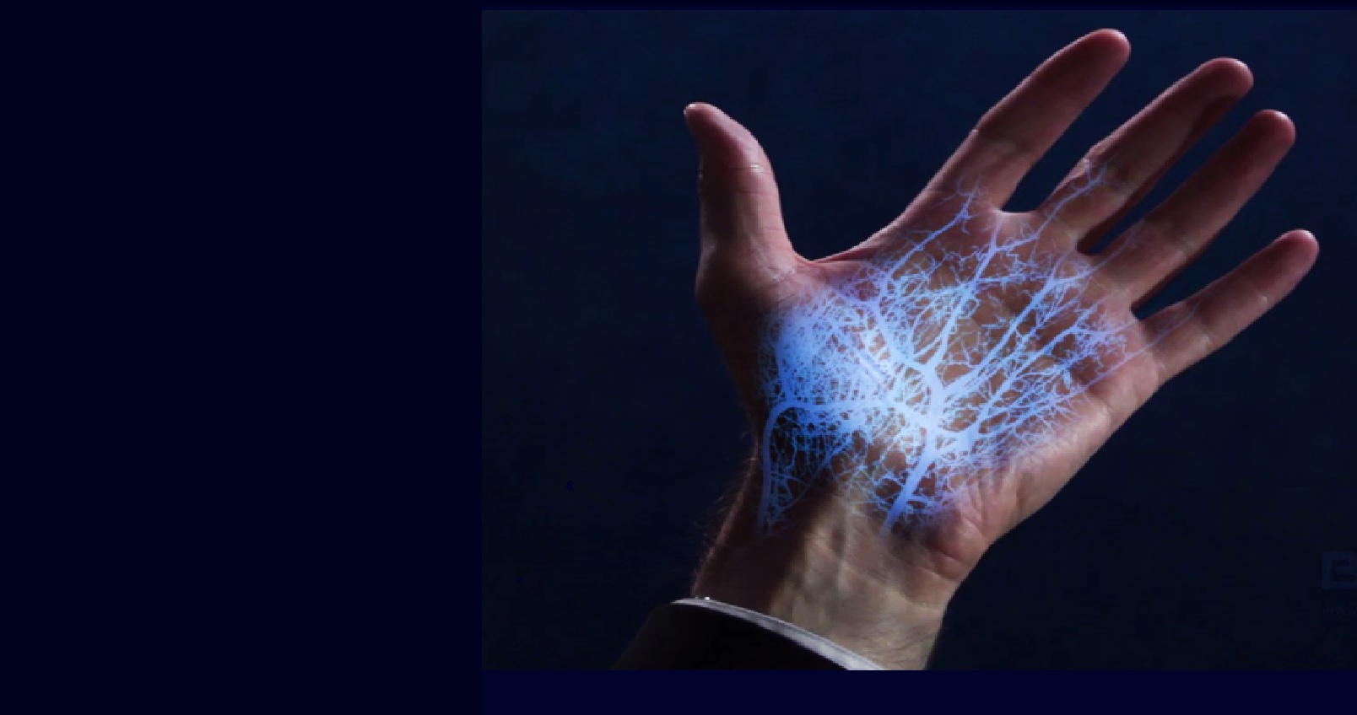
Finger Vein Recognition
Karan Shah
karan.shah@u.northwestern.edu
Tina Shin
minjushin2017@u.northwestern.edu
EECS 395/495 : Biometrics
Fall 2016

Slide 2
Contents
Introduction
Definition of Finger Vein Recognition
Research Purpose & Goals
Methodology Description
Database and algorithm
Experiment
Findings
Method Proposal for Improved Performance
Score Calculation
Experiment
Results
Conclusion and Future Work

Slide 3
Finger Vein Recognition
Biometric method which relies on the human finger vein patterns under the skin surface for personal identification
All 10 fingers of a user have different vein patterns
Patterns of the veins inside fingers are captured with infrared light

Slide 4
Current Vein Recognition System
Among 10 fingers, index and middle fingers from both hands are being used
Which finger, out of the 4, is the best has been controversial
Ajay Kumar vs B. Ton

Slide 5
Research Purpose
To comprehensively study the performance of different fingers
Experiments show that the performance of different fingers is algorithm and database dependent
To propose an algorithm that computes the best finger for each user
To improve the performance of the system as each user uses his or her best finger

Slide 6
Experiment Setup
Database
Collected from finger vein recognition system used at university
Database A: 739 users * 4 fingers (Left Index, Left Middle, Right Index, Right Middle) *3 samples each finger = 8868 samples
Database B: 347 users * 4 fingers * 3 samples = 4164 samples
Algorithm
Algorithm 1: existing finger vein recognition system used at the university
Algorithm 2: state of the art technique; wide line detector
Algorithm 3: state of the art technique; repeated line tracking

Slide 7
Experiment Description
Database Separation
Divide each database into 4 fingers
[insert diagram]
Algorithm Application
EER, DET curves

Slide 8
Findings
When an algorithm is applied on different databases, the performance of different fingers differs.
When different algorithms are applied on the same database, the performance of different fingers differs.
=> Performance of different fingers is algorithm and database dependent.

Slide 9
Proposed Method
Calculate score for 4 fingers and determine the finger with highest score as the best finger
[insert formula]
2. Perform experiments to test methodology

Slide 10
Results
EER for the scenarios [insert table]

Slide 11
Conclusion
The performance of different fingers rely on the algorithm and database
The proposed method of finding the best finger in order to improve the performance of finger vein recognition system has proved its efficiency

Slide 12
Future Work Possibilities
More research on stability of the best fingers since the best finger for a user may change due to increase in database size
Find a method to determine which finger the user is using and whether he/she needs to change to use a better finger
Design a good algorithm that treats different fingers equally to stabilize the performance despite the finger type

